Slide 1
XML Overview
XML Stands for Extensible Markup Language.
XML is a markup language much like HTML.
XML was designed to describe data ( data is embedded between tags that describe it)
XML is platform and language independent
XML is used for
Transport or Exchange Data
Sharing Data
Store Data
Creating New Languages.

Slide 2
Example XML Document
<?xml version="1.0" ?>
<EmpList>
<Emp>
<name>Martin</name>
<Designation>TeamLeader</Designation>
</Emp>
<Emp>
<name>David</name>
<Designation>Test Engineer</Designation>
</Emp>
</EmpList>

Slide 3
XML applications of today
WML(Wireless markup language)
MathML(Mathematical Markup Language)
XHTML
XML-RPC
EDI (Electronic data interchange)
XML document in Web services, deployment descriptors in enterprise application etc.

Slide 4
Origin
XML and its related technologies are developed and approved by W3C.
Released in December 1997.
SGML (Standard Generalized Markup Language by IBM) was the first language that was used to describe data.
XML is successor to SGML, simplified and adapted to internet.
XML as been used to define successor of HTML called XHTML.

Slide 5
Structure of XML Document
<root> <child> <subchild>.....</subchild>
<subchild>.....</subchild> <subchild>.....</subchild> <subchild>.....</subchild> </child> </root>

Slide 6
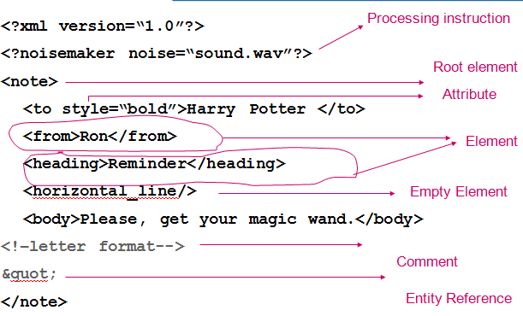
XML Overview

Slide 7
XML Overview
XML documents must contain a root element. This element is "the parent" of all other elements.
All elements can have text content and attributes
All XML Elements Must Have a Closing Tag
XML Tags are Case Sensitive
XML Tags are not Predefined tags we have to create our own tags.
XML Elements Must be Properly Nested
<b><i>This text is bold and italic</b></i>

Slide 8
XML-Related Components
DTD (document type definitions): gives specifications for the tags in XML[Validating xml Document]
XML Schema: an alternatives to DTD
XML parser
XPath, XLink, XPointer: used for navigating and linking
XSL[Extensiable style sheet language]: style sheet for XML
XSLT[Extensiable style sheet language Transformation]: To transform XML
Namespace: used to overcome clashing names of tags

Slide 9
Well-formed Constraints
All XML elements must nest correctly.
XML tags are case sensitive. The case of the start tag and its corresponding end tag must match.
All XML documents must have one and only one Root element
All the elements (other than the root)must have one and one parent.
Attribute values must always be quoted
Empty tags must end with a ‘/’.
An XML document that confirms to the above rules is called a “Well formed” XML document

Slide 10
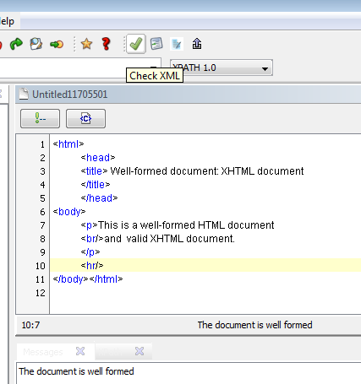
Example: XHTML
Notes:
XHTML is HTML strictly following XML rules. The advantage of this is that XHTML document have other XML based mark-up tags. Application can use these mark-up language for extracting data. XHTML can also be used with XSLT.

Slide 11
Attributes
Attributes are used to attach the information about the element.
Attribute is a name-value pair
Attribute values can be any text, entity reference or character reference.
Attribute values cannot contain special characters.
Attribute value must be enclosed with double quotes.
Only one instance of attribute name is allowed.

Slide 12
XML Overview
<bookstore> <book category="COOKING"> <title lang="en">Everyday Italian</title> <author>Giada De Laurentiis</author> <year>2005</year> <price>30.00</price> </book> <book category="CHILDREN"> <title lang="en">Harry Potter</title> <author>J K. Rowling</author> <year>2005</year> <price>29.99</price> </book> </bookstore>

Slide 13
Entity references
5 built in entity references &lt; &gt; etc.
Apart from these 5 entities, number of other entity references are also defined like &copy; &nbsp; etc.
Use &lt; for <
Use &gt; for >
Use &amp; for &
Use &apos; for ‘
Use &quot; for “

